Slide 1

Introduction to Neo4j - a hands-on crash course
dev.neo4j.com/forum
dev.neo4j.com/chat

Slide 2
This is an interactive session!
Tell us where you're from!
And please ask Questions
as we go along!
In any of the chats
Notes:
How do I get started with Graph Apps?

Slide 3
In this session
We will cover:
What is a graph and why they are amazing
Spotting good graph scenarios
Property graph database anatomy and introduction to Cypher
Hands-on: the northwind graph on Neo4j AuraDB Free
console.neo4j.io
Continuing your graph journey
Useful reference: https://dev.neo4j.com/rdbms-gdb
Notes:
And today we want to look at graphs in general. Why are graphs really cool? Why are they basically a really great representation of the real world? Where can we use graphs? What are scenarios or use cases for using graphs? Looking a little bit at the property graph model and a quick introduction to Cypher, our query Language. And then what we you actually want to do is we want to go hands-on. And all of you can code along with us here because we can use Neo4j AuraDB Free, which I think was already shared in the registration notes that you should have set up an account there. So it should be pretty straightforward and quick to create a database there. And I thought today also to make it a little bit more fun, we'll have a look at some Stack Overflow data to see what we can do with something where I guess most of you spent quite some time every day. And so we can look at some Stack Overflow data and then I'll show you where you can continue your graph journey and such.

Slide 4
Because it takes a few minutes to launch
Let's get started on
AuraDB Free
neo4j.com/aura
Ask in the chat if something doesn't work!
Notes:
And before we start with the actual content, let's go over to Aura and log in and create our database so that we can together then have the database ready when we start. So it takes two to three minutes to start the database. So from that perspective, we can start it now. And then when we come back, it'll be there and up and running.

Slide 5
Time to have a go! With AuraDB Free
We are going to:
Go to console.neo4j.io
Register (need to verify email)
Login
Select Top Left "Start Here" Database
Click “Create Database”
Download the generated credentials - keep it safe! (The .env file can be opened with any text editor)

Slide 6


Slide 7
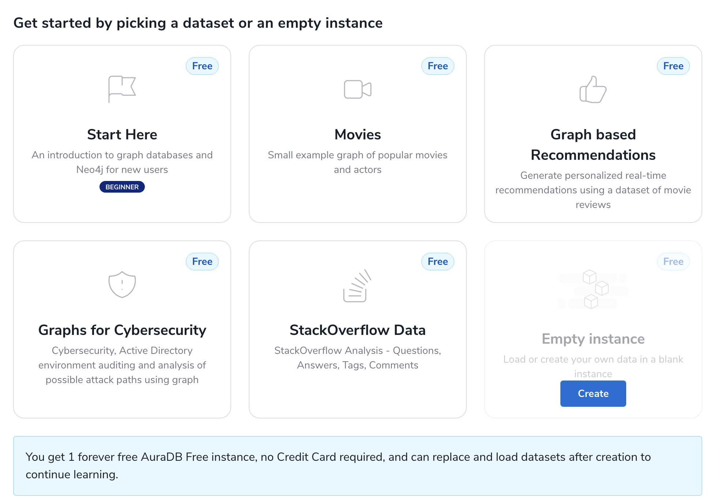

Slide 8
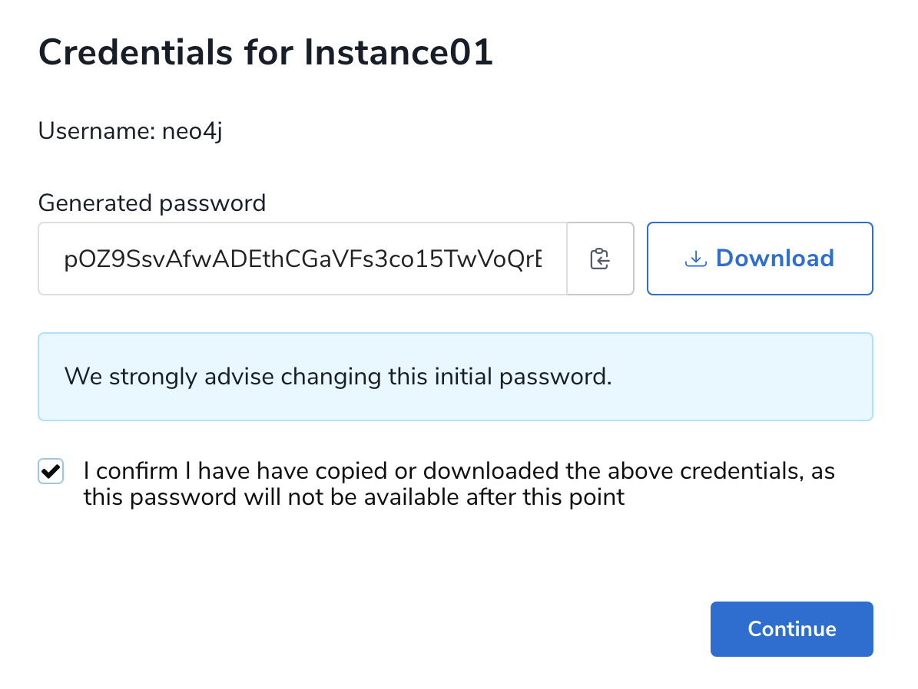

Slide 9
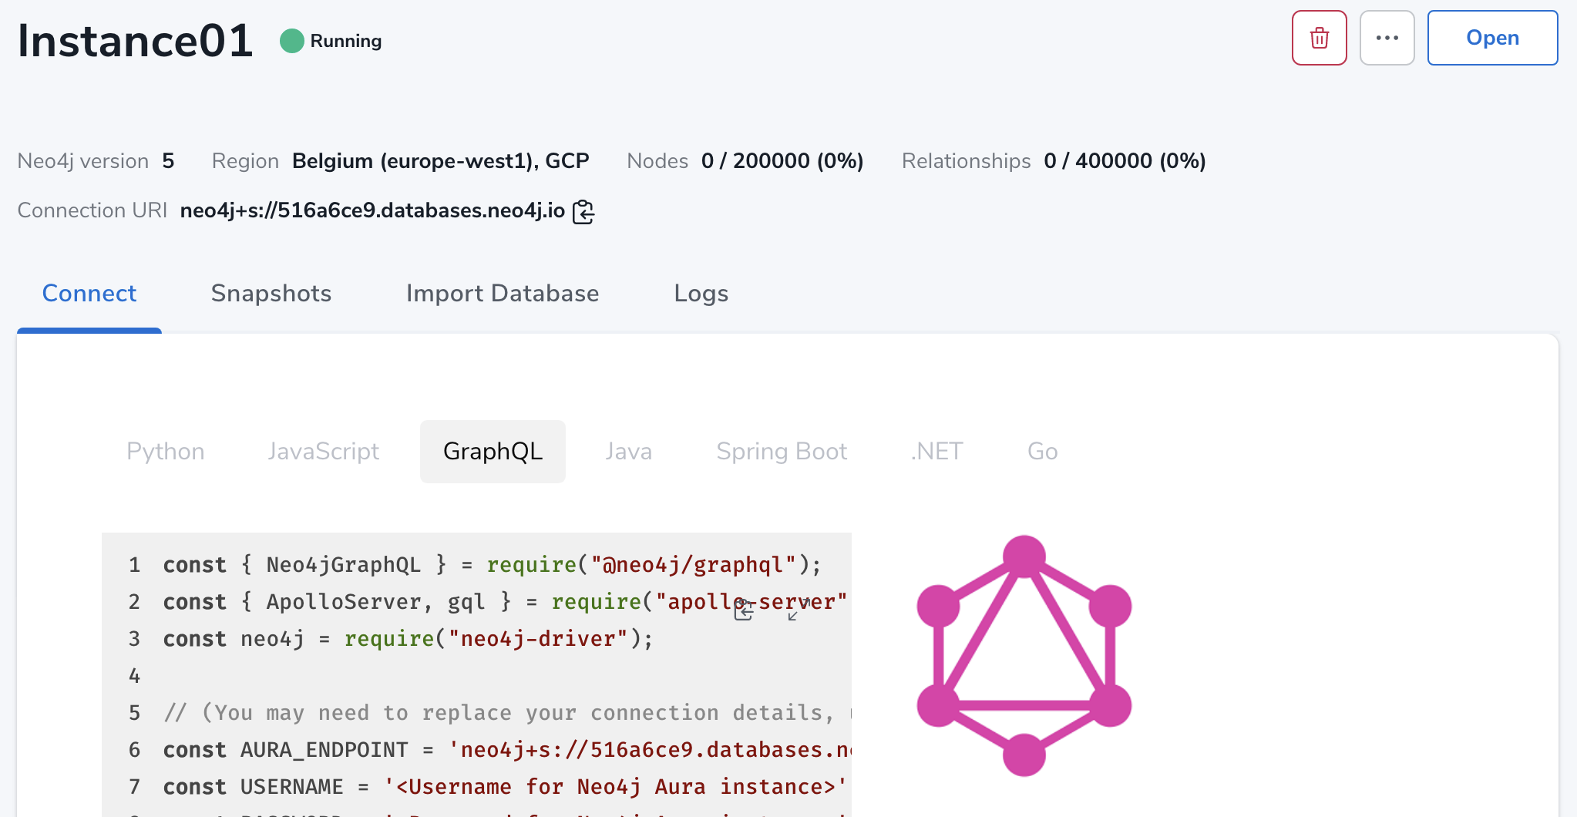

Slide 10
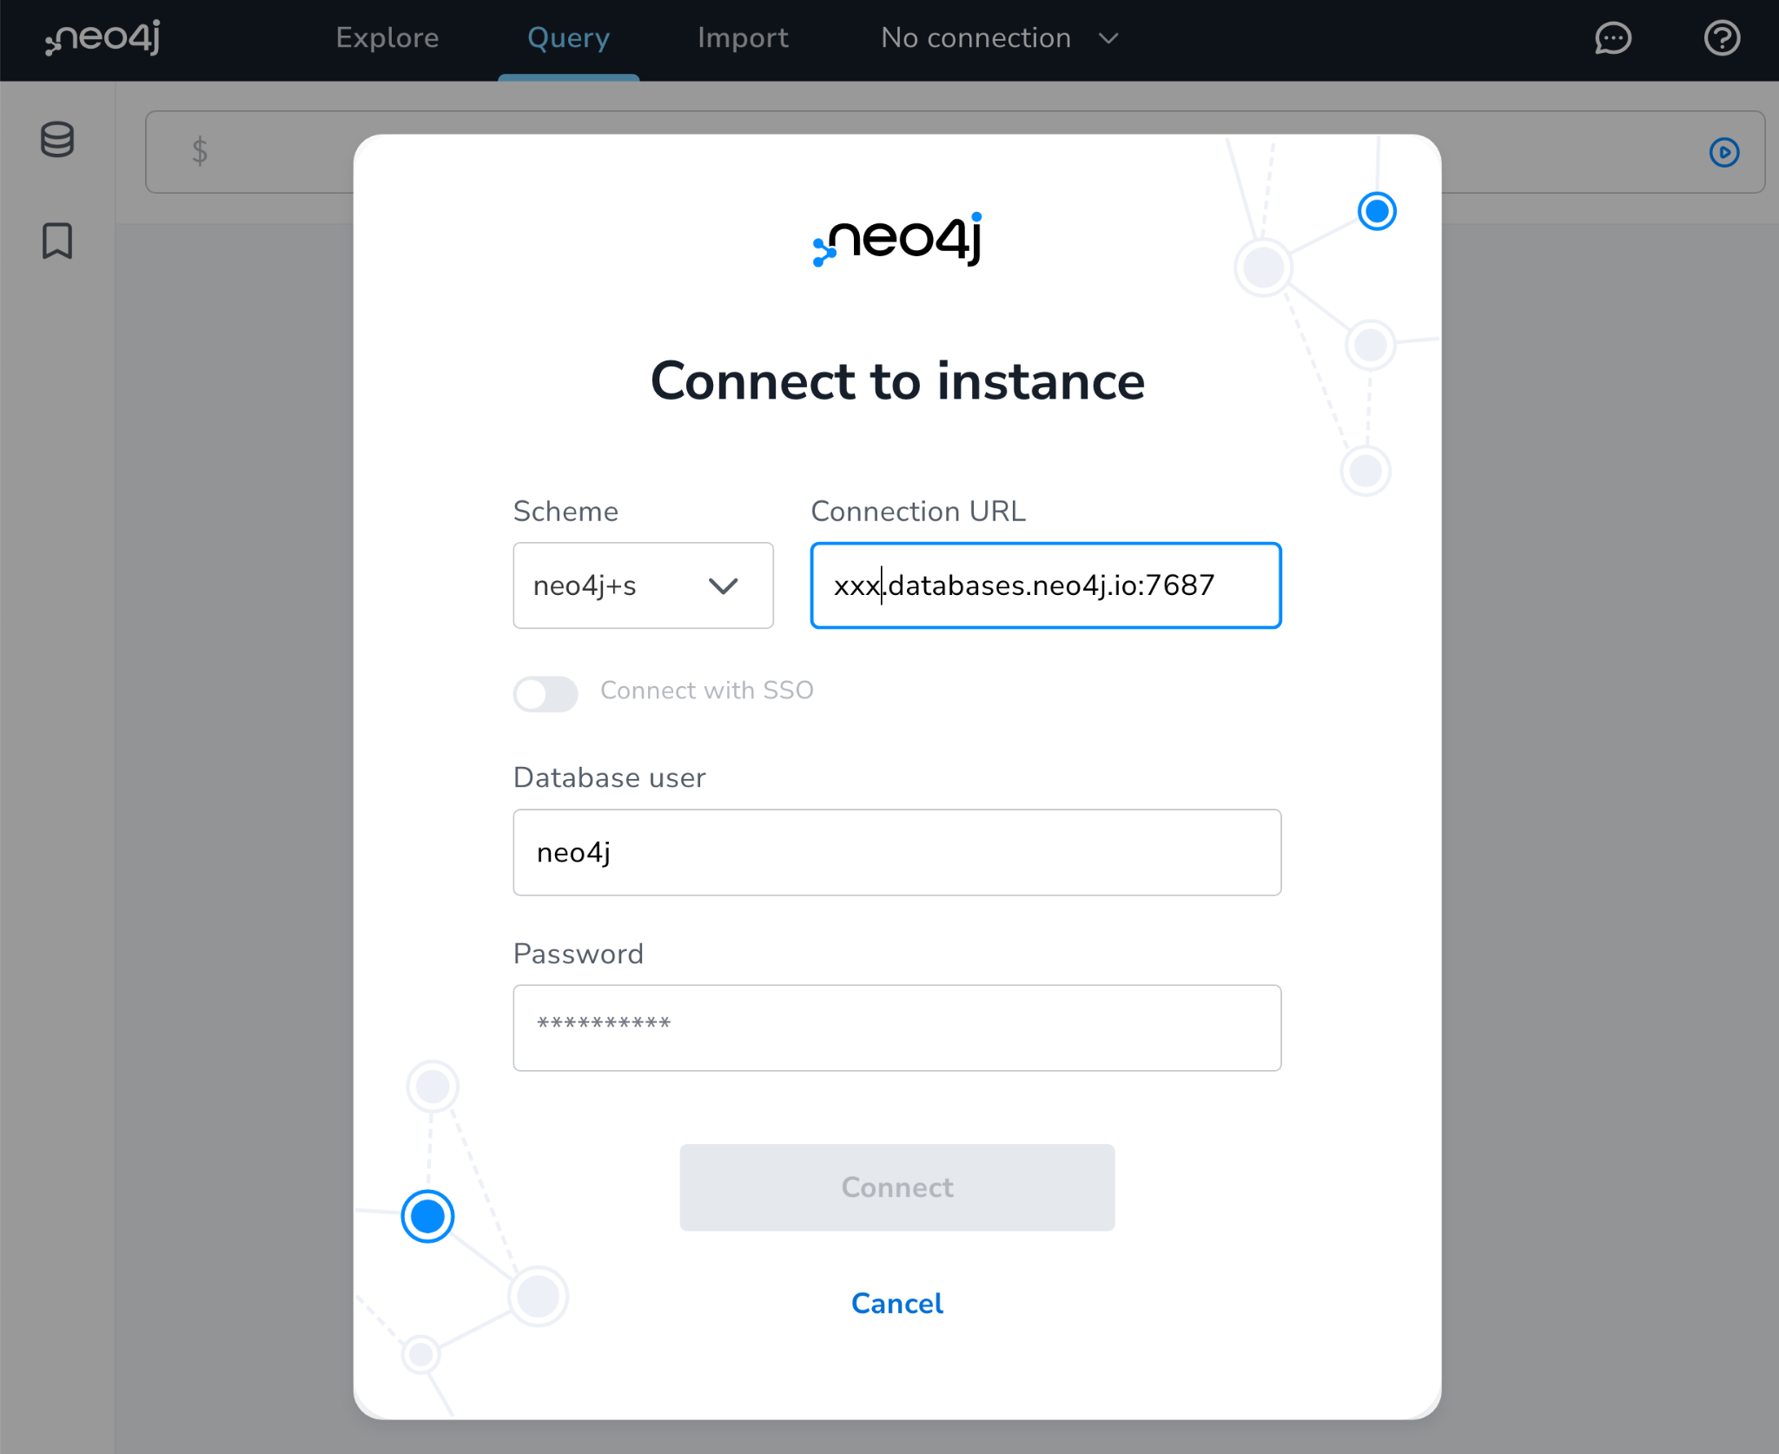

Slide 11
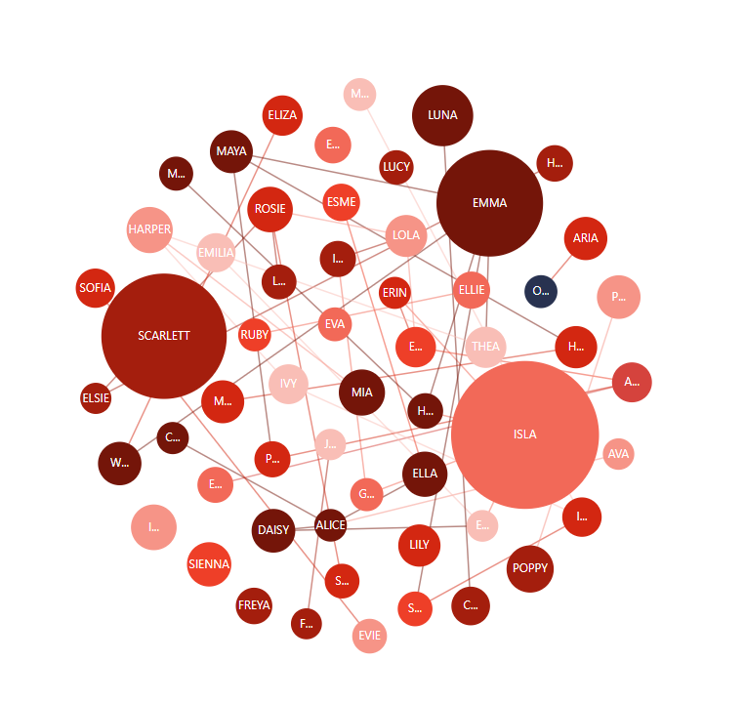
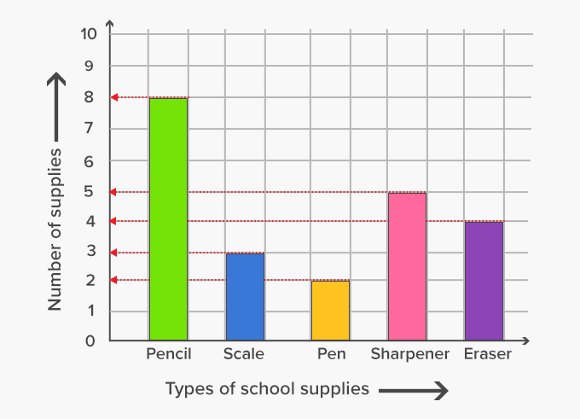
What is a graph?
versus
Notes:
Okay, what's a graph? Is it the thing on the left or the thing on the right? We should actually add Paul, Alex, to our sessions. That would be fun, perhaps that's for next time. So actually what we call a graph is the thing on the left. It's a network of connected entities or connected nodes. On the right side, especially in the US, oftentimes people call this a graph. We prefer to say like diagram or chart to make the distinction. So for us, a graph and a network are what we are talking about versus diagrams and charts. It's easier in German because then you wouldn't say a graph to the thing on the right side, but there's also graph paper, right? So it also adds to the confusion as well.

Slide 12

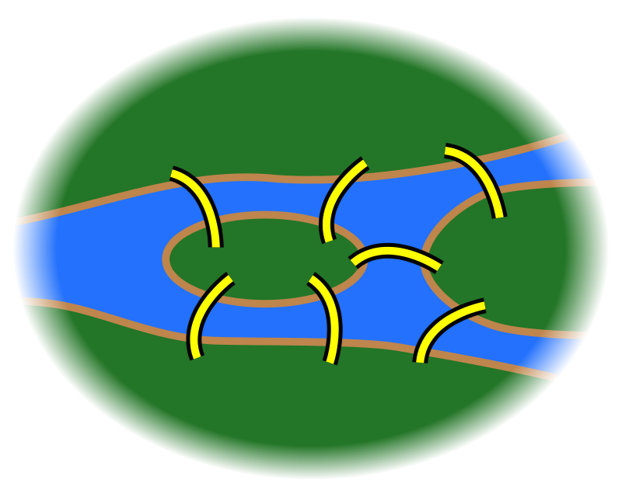
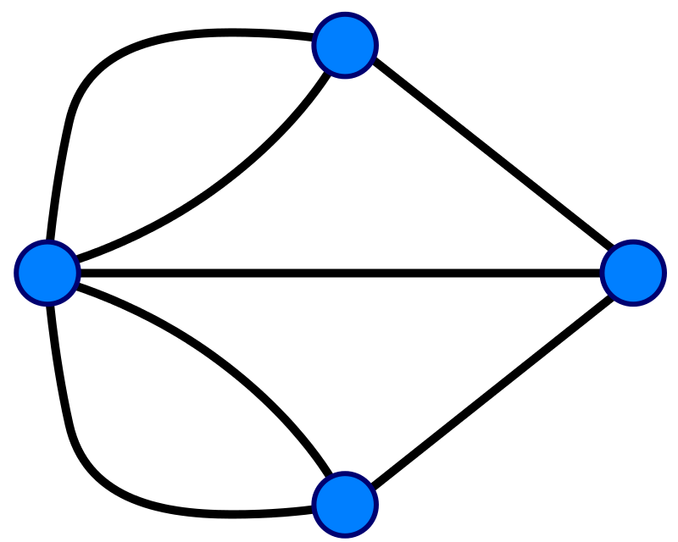
A graph is...
...a set of discrete entities, each of which has some set of relationships with the other entities
Seven Bridges of Konigsberg problem. Leonhard Euler, 1735
Notes:
First of all: what is a graph? A graph is a collection of objects, each of which has a set of binary links with the other objects. Graphs are a useful way to model data for the purposes of mathematical analysis, and they have been around for quite a long time. The first use of graphs was by Leonhard Euler in 1735; he used graph theory to prove that the famous Seven Bridges of Konigsberg problem had no solution. If you’re curious, we can talk about the Seven Bridges problem and Euler’s proof, but this is all deep background for the main topics of interest.
************************************************ ***** Optional: What is the Seven Bridges problem? *****
Konigsberg, Prussia (now Kaliningrad, Russia) is a city spanning the Pregel River. It includes two large islands, which are connected to one another and to the river banks by seven bridges. A map of this arrangement is pictured on the left. The Seven Bridges problem is this: is there any possible route through the city that crosses every bridge exactly once?
Some pen-and-paper experimentation will quickly suggest that there is no such route. However, PROVING that there is no solution is much more difficult; Euler invented Graph Theory as a tool to aid this proof. The graph representation of the problem is on the right: four landmasses, each represented by a node, and seven bridges, each represented by a relationship
************************************************ ****** Extra Optional: What was Euler’s proof? ********
Euler observed the following:
The route taken within each landmass is irrelevant. Only the sequence of bridges crossed matters.
Whenever you enter a landmass via a bridge, you must leave it by a different bridge
...except at the start (where you leave but do not enter) and at the end (where you enter but do not leave)
Ergo, for the problem to be solvable, every landmass (except the start and end) must be touched by an even number of bridges
Based on the above observations, the problem has no solution, because all four of the landmasses are touched by an odd number of bridges.

Slide 13
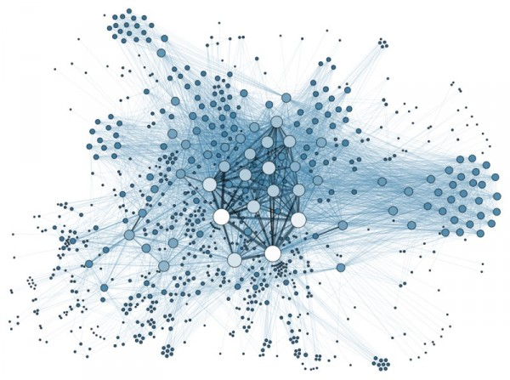
Anything can be a graph - do you have examples too?
the Internet
a water molecule
H
H
O

Slide 14
Why are graphs amazing?
Notes:
Okay, what are graphs in general? So actually everything that you can connect is a graph. So I always say there's no such thing as disconnected pieces of information in the world, right? Or disconnected pieces, period, right? So there's people who have connections, historical events which kind of have reasons why they happen, but they also have outcomes. There is things like proteins in biology, for instance, right? There are things like markets, economic markets. Especially today, we see that a lot, like there's so many dependencies on markets. If someone cuts someone else off a market, then they have a lot of problems, right? And not just directly, but also transitively. So not just the organization that's cut off from the market, but also all their dependents, right? So things like network dependencies in software. For instance, what about my libraries and the libraries' libraries and transitive dependencies? And what about security there, right? So what happens if one of these libraries that I'm not directly depending on but I'm depending on like three steps removed has a security issue? I'm still affected by that because I transitively use this library. So there's lots of things. So here, for instance, water is a very simple molecule, but you of course know proteins and DNA and all kinds of organic molecules are complex networks. And then it's not just a body primary structure, but also a secondary and tertiary structures. For instance, for protein folding, that can also be the represented as graphs as well, right? And so transport networks, there's like information networks, there's even like data centers and all the cabling routers, switches and so on. So basically the means are endless. Whenever you can basically draw something on a whiteboard with arrows and circles, that can be represented as a graph. So I think graphs are everywhere. And I think that still holds true even 12 years later since I started in Neo4j.

Slide 15


Slide 16
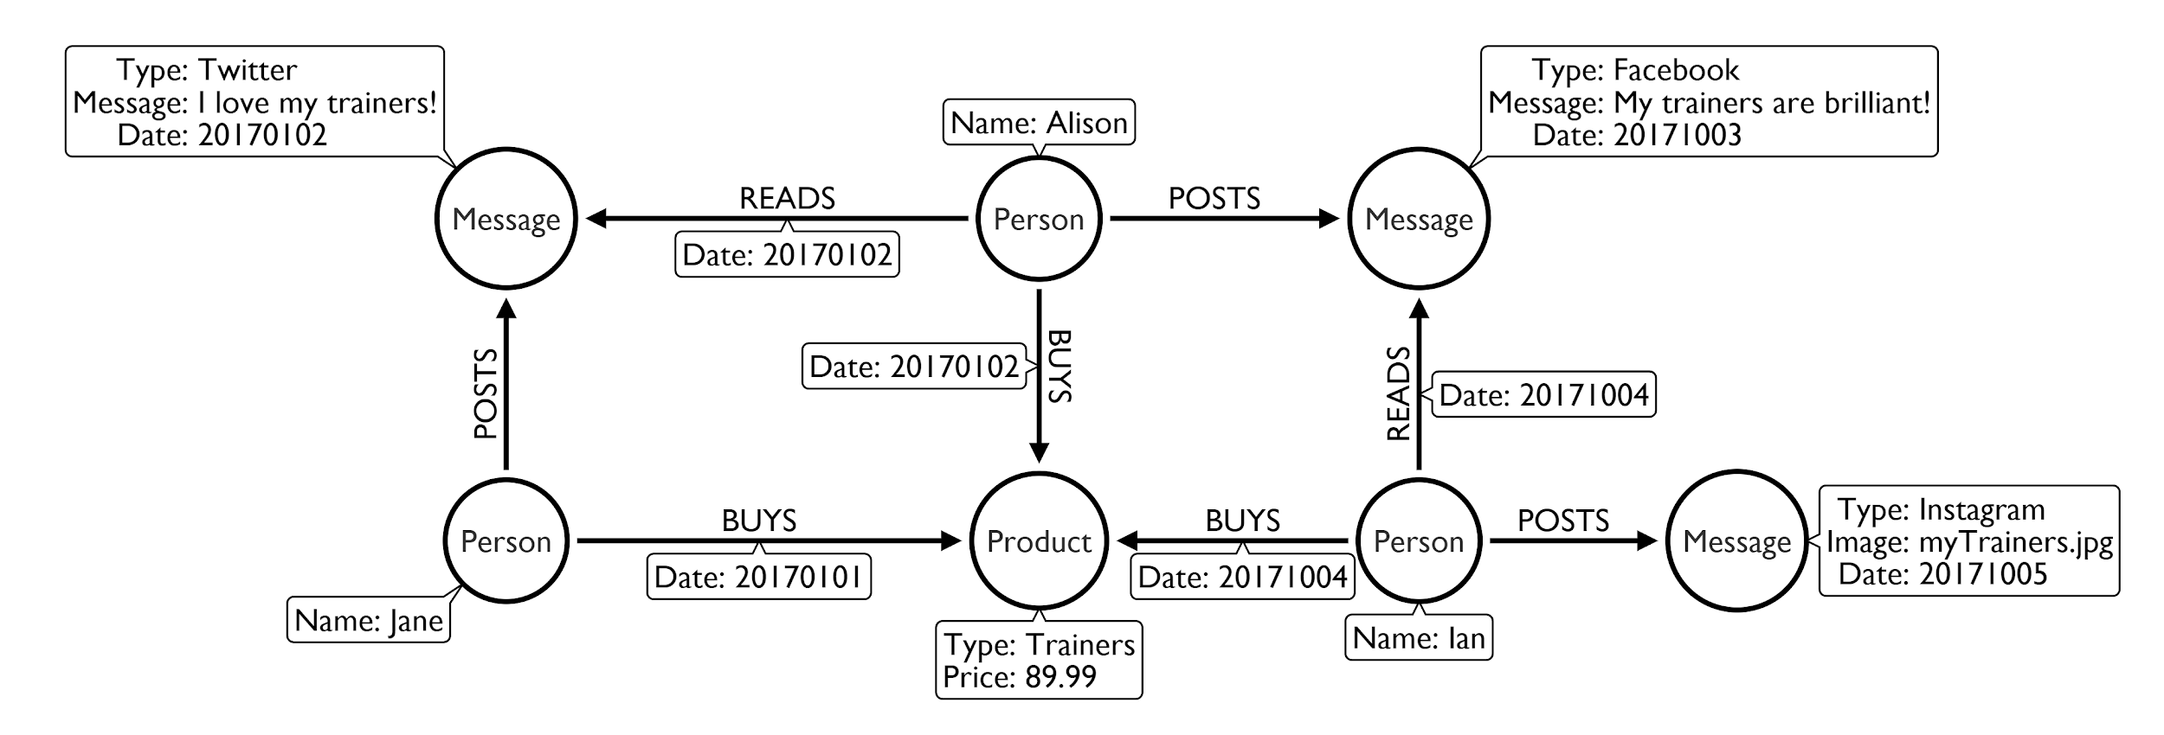
Follow the flow - buying trainers
Notes:
Why are they amazing? Because they can represent the data that you have pretty straightforward, right? So this, for instance, is an example of someone or some people buying trainers as a product. And so you can represent the product, but what you can also represent the people. You can say, what did they do with the trainers? They bought them, right? They didn't kind of sell them or wore them, but they bought them. So that's kind of the BUYS on the relationship. And then you can also capture when they were bought. You could also capture what was the price that they were bought at, or the location and things like that. So you can start with a simple model like this one, but then you can evolve it to a more complex model where you either have orders and transactions and like shopping baskets with multiple items and things like that. And then you can say, okay, based on what people bought, you can recommend them other things that they could buy. For instance, you know some jogging pants or running outfit that goes with the trainers. Or if they're like more trainers for fashion, then probably the appropriate fashion outfit or whatever. Or like a running course or gym membership or things like that, right? So that's kind of things that you can do with this. And this is really simple thing that you can easily draw on whiteboard. Usually you have two options. So either you draw an example on the whiteboard, like you see here where you really have like Alison, Jane and Ian as people, and certain piece of trainers, type of trainers, as a concrete example. Or you draw a meta model there where you basically have to say Person BOUGHT Product, or Person BUYS Product, right? And then that's the meta model. So that it's kind of different ways of presenting these models. And then because graphs are really flexible, so there's no fixed schema that you have to create upfront to manage a graph. You can add data from other sources, right? So someone posts a message on social media, other people rate these messages on social media. And then basically if you look at the dates here, then they actually based on reading that message, they actually go off and buy their trainers. And then they post on the next day their own message, right? And then someone else reads this and goes off and buys the other things. So that's actually social influencing in a nutshell, if you want to say so, right? So that's kind of how does like a hype product suddenly go viral, right? So there was this interesting book, "The Tipping Point," by Malcolm Gladwell, when does something become viral and you can present it as a graph. And then you can also trace why is this product suddenly selling so well. Oh, there's a lot of people talking about it or special people that have a lot of followers or influence are talking about it. And you can basically follow all these relationships in a graph. And here you already see that we have actually merged two graphs, right? So it's actually three. So we have the purchase graph with the people and the purchases, but here's also the social graph, one for Twitter and one for Facebook, for instance, or Meta. And so you can also imagine pulling data from other places to enrich your graph data, right? So then you could also add logistics and shipping information, or if you wanted to, if this is really like a sports domain, then you could add information about where people using these products and connect it to Strava and have the running loops of people all around there as well, right? And then you basically can pull in more information and because in a graph as soon as you have one connection point, one joint that you can connect things to, you need only one place where you connect a new piece of information to it, then you can grow your graph and add more information from other sources to it. So it's pretty powerful, both in its simplicity but also in it's flexibility and extensiveness as well. Which I personally still love really a lot. Right, and you can continue to extend this.

Slide 17
Panama, paradise, pandora papers:
simple model, powerful outcome
Notes:
One other good example of where graphs have been used quite widely is journalistic investigation. So today we are living in a time where journalists and journalism, especially investigative journalism is more important than ever because many often the pieces of information that we would like to know are actually hidden away in secrecy or in shell companies or money flows somewhere where we don't want to go. And so, thanks to journalists, this kind of information coming from leaks is captured, analyzed, and they actually do the job that actually banks and governments should do basically is trace ownership. Trace ownership of companies, trace ownership of ships, planes, and other things, of money, of shares, of influence, right? And so the basic domain model of these investigations from the ICIJ, it's basically the Entity is a shell company. The Officer is someone who is kind of responsible for some part of the shell company. Either they're the owner or shareholder, or they're an director or officer, right? But what's actually really interesting is the shareholder, which is kind of usually hidden away. The director and officers are usually public, but they are usually employees of a law firm or an offshore entity that they pretend to be directors of the shell company. But sorry, but the actual original shareholders or beneficiaries or real owners of the shell companies are not in any public registries. That's why in these data leaks, this information also becomes public. And then you see kind of politicians, celebrities, and other people putting money away and then using shell companies to just trade, right? So instead of me giving you a million dollars, I just hand you a shell company that has a million dollars worth of equity. And I can do this behind the scenes. And no one knows from whom to whom something like this moves. And then Intermediaries are all the banks and in law firms that help Deutsche people basically to hide their money by working with these shell companies and offering these shell companies and such. So that's a pretty simple model and we can use this for actually drawing a lot of conclusions, right? So because through shell companies, you can connect Officers even over five or six hops, you can say from this one person A to this person B, what's the path that we can go through shell companies that reaches one to the other, for instance? Or who has been jointly investing or been shareholder of the same shell company over and over again. So those two people have a lot of connections. So they are more tightly connected and such. So we'll see an example of that in the Stack Overflow data model, you know.

Slide 18
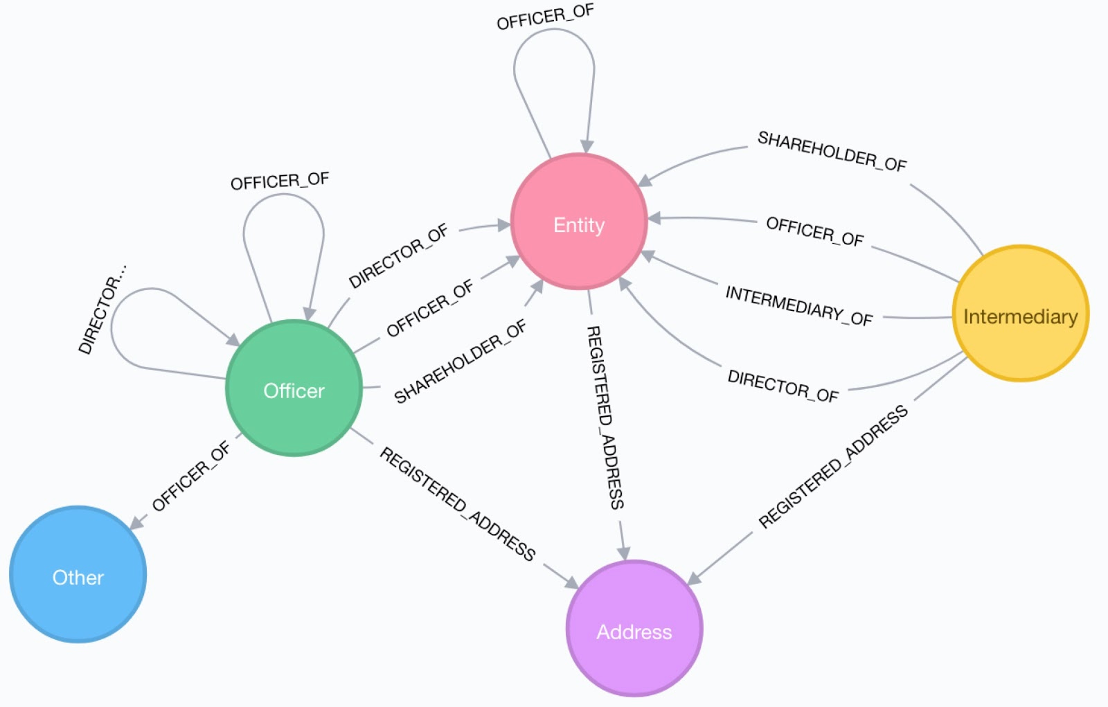

The ICIJ Investigations data model...

Slide 19
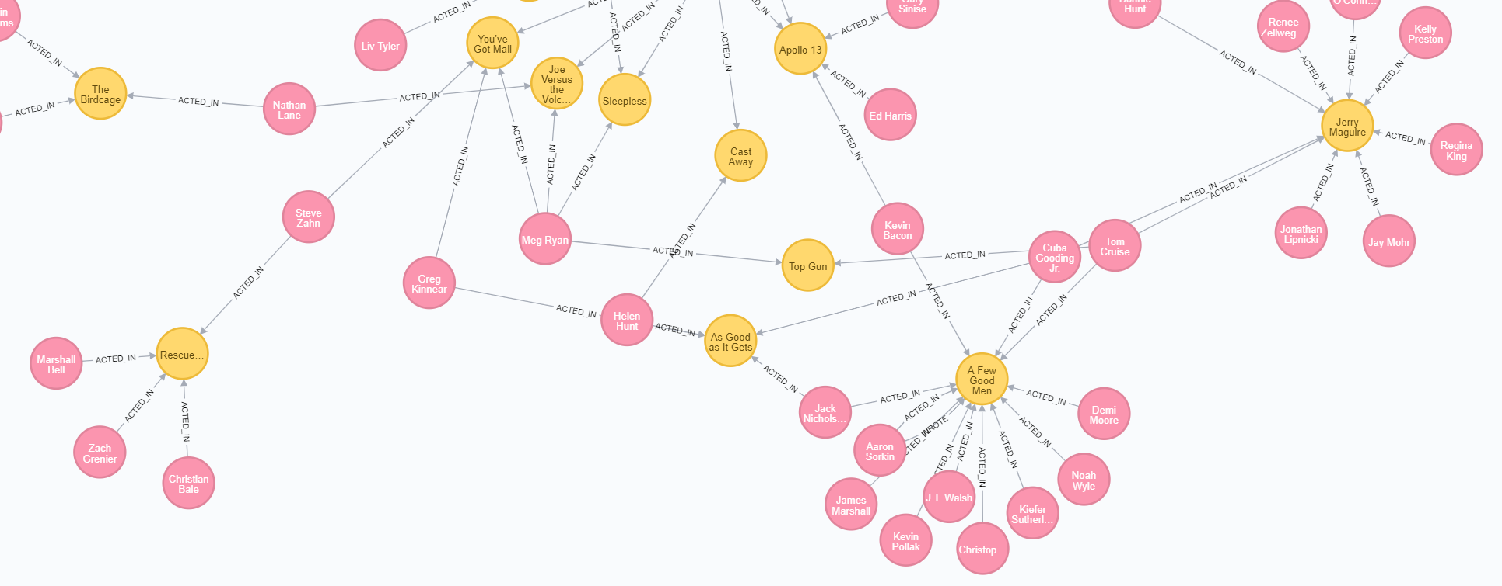
Friends of friends
...or co-actors of co-actors

Slide 20
What are good graph scenarios?
Notes:
How do I get started with Graph Apps?

Slide 21
Identificando bons cenários para uso de grafos
Compreender relacionamentos entre entidades
Autorreferências no mesmo tipo de entidade
Recomendações
Detecção de fraude
Identificação de duplicatas
Linhagem de dados
Redes sociais
Hierarquias organizacionais
Gestão de acessos
Influenciadores sociais
Relações “amigos de amigos”
the Internet
the Internet
Descobrir rotas ou caminhos diferentes
Explorar relacionamentos de profundidade variável
Logística e roteamento
Gestão de infraestrutura
Rastreamento de dependências
Visibilidade da cadeia de suprimentos
Lista de materiais
Gestão de redes
Roteamento
Notes:
grafos são ótimos para modelar relacionamentos e contextos complexos, mas não para processamento numérico massivo, ingestão de streams em tempo real ou armazenamento bruto de arquivos.

Slide 22
Componente de um grafo
Nó (Node)
O principal elemento de dados a partir do qual os grafos são construídos
Jon
tênis
Notes:
So what does the property graph model actually look like? So I already mentioned it a number of times. What you have is these entities or elements that we call node, in math and science, it's often also called a vertex, but we felt that vertex is not a very friendly term and people are scared away, so we kind of call it node, which is more obvious what it means. And between nodes, there are relationships. In Neo4j, in particular, relationships are directed, but you can ignore the direction if you want to. And relationships always have a type, right? So because otherwise there would be just anonymous relationships and we all always want to have a type for a relationship, right? And really kind of the most important rule in graph database is there are no broken links. So there are no 404s in a graph database. If you have a relationship, then there's always a node on either side of the relationship, right? Or you don't have a node that points somewhere, but it's not there anymore. So that's kind of a rule of graph databases that that's kind of a core consistency attribute of a graph database. There are no broken links. There's always something that a relationship points to. And so that means I can't delete a node until unless I also delete its relationships. So as long as a node still has a relationship, I can't delete it as such.

Slide 23
Componente de um grafo
Nó (node)
O principal elemento de dados a partir do qual os grafos são construídos
Relacionamento (Relationship)
Conexão em dois nós. Possui:
Direção
Tipo
Um nó sem relacionamentos é permitido. Um relacionamento sem nós não é permitido.
Jon
tênis
POSSUI

Slide 24
Propriedades Banco orientado a grafo
Nó (Node)
Relacionamento (Relationship)
Label
Define o papel do nó (opcional).
Pode ter mais de um
:Person
:Vehicle :Bike
OWNS
since: 2018
Propriedades
Atributos que podem ser associados a nós e relacionamentos.
name: Jane
make: Specialized
model: Crux Pro

Slide 25
Property graph database
Node (Vertex)
Relationship (Edge)
Label
Define node role (optional)
Can have more than one
:Person
:Vehicle :Bike
OWNS
since: 2018
Properties
Enrich a node or relationship
No need for nulls!
name: Jane
make: Specialized
model: Crux Pro
Notes:
Jane owning her bike. This is basically a person owning a bike, right? So that's kind of type Bike and type Person as such. And you can have more than one. Then you can also say, okay, that's not just a bike, it's a vehicle, and then there are other types of vehicles as well that person can own, right? And then on both on nodes and relationships, you can add arbitrary properties. So properties are just key value pairs, and you don't need to declare them upfront. You can add as many or as few properties as you want. And so you don't need to prepare a schema or something like that. So there might some might be some users where you only know the name or login. And some other users that fully filled out their profile. You have all their information here as well, right? And that's something that's quite nice about a graph database that these kind of attributes or properties are also dynamic. So you just store the ones that you have and you just leave off all the ones that you don't have. So for properties on relationships, oftentimes they qualify the relationships. So there's, for instance, something like a cost or distance or timeframe or things like that, or is it active or not active? That's what you would put on a relationship property. But of course you can also put other things there, right? But that's common usage of properties on relationships as such.

Slide 26
Cypher
Cypher é a linguagem de consulta declarativa do Neo4j e sua sintaxe é baseada no ASCII-art ¯\_(ツ)_/¯
Elementos da Linguagem
Nós: Representados por parênteses (), os nós podem ter label e propriedades no formato chave:valor. Exemplo: (:Pessoa {nome: "João", idade: 30})
Relacionamentos: Representados por setas -> ou <- para indicar a direção, os relacionamentos conectam dois nós e também podem ter propriedades. Exemplo: (a:Filme { titulo: "Matrix" })<−[:ATUOU]−(b:Ator { personagem: "Neo"})
26￼
Notes:
Okay, and how would I create this graph database? Of course there are slides, but I actually want to do this with you together. So I just do the first few slides, and then we go into the real graph as such. So we query Neo4j and many other graph databases with Cypher, which is a pattern-based query language. So we looked at, initially, we looked at SQL. We looked at other query languages. We looked at SPARQL and others. But we didn't feel that any of those as really well suited for graphs. Either it's too verbose or too cumbersome or too unwieldy. We wanted to have something that's still humane, that's easy to read, easy to understand, can represent graphs really well. And so we built our own query language. Initially for Neo4j, but then open-sourced to everyone. And so now with open Cypher, everyone can use Cypher as a query language as well. And many graph databases already do as well. So it's a declarative query language like SQL. It's very expressive. I think it's pretty done good in kind of representing complex queries with a few lines of Cypher. It supports pattern-matching which is kind of the, everything is around pattern-matching in Cypher. And you'll see in a second, what I mean with pattern-matching and it has ASCII art. What else would you wish for?

Slide 27
Cypher
Cláusulas
As cláusulas adicionam lógica às nossas consultas:
MATCH: Encontra padrões no grafo.
WHERE: Filtra resultados com base em condições.
RETURN: Define os dados que queremos retornar.
CREATE: Cria novos nós e relacionamentos.
SET: Atualiza propriedades de nós e relacionamentos.
DELETE: Remove nós e relacionamentos.
Notes:
Okay, and with that, I actually want to leave the slides and go into our database. So as you're the remember, we have our Movies database running. I hope for all of you your Movie database also is now green and running. And what you can do is you can click on this "Open with" button and pick Neo4j browser as our interaction tool because that's like an interactive query UI that allows us to query the data. And so we have our database connection URL already filled in, username is Neo4j and the password is what I just pasted here into my browser tab. And you hopefully stored it safely somewhere, right? So now I have my connection to my database. And because we started with the Movies dataset, this database is already filled with some example data, not a lot, but it's a small, cute, light, little tiny dataset, so we have Movies, People, and a bunch of relationships here. And it's 171 nodes and 253 relationships. So it's really just an example dataset. You can start by clicking on one of these. So for instance, you can click on People and say, okay, what do we have here? We have 25 people. It's says LIMIT 25, so we have 25 people. Here on the right side we have the legend for our nodes as such. So if you hover over a node or click on a node and you see the attributes of a node here. You can also fold this in and fold this out or make it bigger or smaller depending on what you want to do. And then if I have these people here, I can, on one side, I can just play chasing nodes all the two hours today. That's kind of one thing that I can do. But I can also click on this and say, "Expand relationships", which is this little icon down Or I can double click also on it. And if I do this, then I see Keanu Reeves acted in all these movies, right? And then I can pick one of those movies, like "The Matrix", for instance, click on that and expand it from here. And then I see suddenly other actors, right? You will be viewing Carrie-Anne Moss and Emil, which is actually a fake. So it's kind of for us to get rid of Emil later on. And then we have directors. So people that have a director relationship to "The Matrix". Lilly and Lana Wachowski, and producers as well. All right, so this is kind of our basic dataset that we can either explore interactively like I did here. So I can for instance, say, okay, what else did, for instance, Lana Wachowski in our dataset at least, write or direct or produce, right? So I can just expand the relationships here and then continue from there. So you can also see that or interactively, I can follow my things like I would draw them on a whiteboard for these kind of small example datasets. Okay. But let's go back to our query language because that's what we wanted to talk about. And as I mentioned in the beginning, Cypher is a pattern-based query language. So if you, by the way, if you want to go to multi-line mode, you can just press shift and enter or shift and return, and it goes into multi-line mode. So it starts out in single-line mode, which is this one, but if I press shift and enter, then this gives me here the multi-line mode. By the way, just quickly, there's more stuff here on the sidebar, so we saw already here the overview of the database on the property keys. I can see more information here. I can store favorites here. So for instance, if I have a query that I really liked, then I just click on this favorite button here. Save as Favorite and then it adds it here. And then I can pick it up from here again and run it and then so on. There are guides. So we can also look at this interactively. So if you get lost or if you don't want to type stuff, then you can also go to the guides and click on any of these queries and it puts them into the input field over here. And then you can use them from here. There are also more guides available and then there's help links to important commands like help keys, quite important. And then other commands as well which are quite useful. Like history is an important command because if you want to look at what you've typed so far and want to save this, for instance, then you can do this. Or what you can also do is show the schema. So for instance, if I click here Run, then I see I have my schema between Person and Movie. And a Person can follow a Person, and Person can acted in, review a movie, produce a movie, write a movie, or direct a movie as well. So I can see actually visualization of my graph schema, of the data and my graph, and a bunch of other things. And then links to docs and to developer guides and GraphAcademy and many other things as well. Settings, most of them, we don't need to touch today. And there's only one that I think it should be checked for you, it's called Connect result nodes which is useful for beginners. When we start our graph database later on, you might want to disable this because that fetches additional connections between nodes that you return. So if I return a bunch of nodes, the browser actually goes and fetches additionally what connections exist between these node. Do you to have a nice graph visualized? But if I already could know what I want return then this Connect result nodes is not so helpful. And then bunch of license links over here. Okay, but what I want to do is we want to interactively look at Cypher. And for that, I just picked my query that I took from click on Person here, and go with this as a starting point. And then we go from here. So I'll turn this into a full screen frame here. So the frame is full screen, and then I can zoom in and out. That's actually a new feature that's actually just made it. So zooming in and out with just my mouse wheel is something that I've been waiting for a long time. So that's really great. And the new features also fit to zoom, which kind of fits my whole graph into the visualization. That's also nice. Okay. But what we want to do is kind of look at some of the Cypher aspects that we can do here. So I just moved us into a multi-line thing so it's easier to edit and move stuff around. So fifth thing that I wanted to show you is kind of these patterns here, right? Here I return the people and then I expanded them. But what I can also do is I can say, okay, give me all nodes, right, give me just 25 random nodes. So I just move this colon person. And then if I do this, then it returns both People and Movies at the same time. And then you see the connect result node actually goes off and creates all these connections between my People. So even by just fetching a bunch of nodes, I get all the visualization of the graph as such. If I don't add a limit, the browser gets a bit too little slower. This needs to basically in JavaScript manage all this graph visualization. There was a recent update to the graph visualization library. So it's a little bit better today, even with a larger data event. So for instance, this is like almost a whole movie database on one screen. And we see kind of clustering around nodes. Like the actors and directors clustering and around nodes. There are some nodes that have joint repeated actors and directors like here is "The Matrix" trilogy. So we don't have like the current movie in here and so on, right? So there's this kind of stuff. So this LIMIT I just say how much data is returned for my query and I just put it back to 25. And this is basically showing me a number of nodes and relationships. This "n" here is a variable, right? So I can call this whatever. I can call it foo or bar or m for movie or n for node. Whatever I want to call it, I'll spell it out. For instance, if I say, I want to just see movies, then I say Movie and then colon Movie is the label. And I just want to return movies. And so it returns 25 movies for me, right? And so whatever I call, this is not important. It's just for me. And I use this to later reference this element I found in my pattern as well. Right. So one thing that we can do with our elements is we can, I already mentioned that we can look at attributes here on in the side bar. But we can also look at the table view of our result, which then shows us the properties. So each movie has a tagline, a title, and a release here, and we can also have a nice ASCII table of this. So if you want to copy the results somewhere, then you can copy this ASCII table quickly as well. Okay. The other thing, if we return like nodes and relationships from our graph, then we see the graph visualization here immediately. But of course you can also return individual properties only. So for instance, we know that movies have titles and a year. And so I just say RETURN movie.title and movie dot, oh it's released, right? Oh, that's actually, of course, how could I forget? There's actually full Visual Studio Monaco code editing support. So you'll get also like highlighting and other things and code completion as well. If you press F1, you get even like typical VS Code commands as well, which is quite nice. So if you want to capitalize something or someone, right? So for instance, if this return was lowercase and I wanted to make it uppercase and I press F1 and then uppercase, Transform to Uppercase, and then my return is beautifully like this. Okay., and if I return this actually movie.title and movie.released, then I get the table back with just these attributes, right? So I can do this both for nodes and relationships. If I just want to return attributes then I can do this. And please come along with me and type these things and do it yourself so you get the feelings for the language. Don't just watch me doing stuff. I actually urge you to do it yourself. Okay, so we had our movies here that we had returned in our graph visualization and what I did before about like this manual expanding from movies to actors, you can actually also do in our query language as well. So for instance, if I want to say I have a person which has some kind of relationship to our movie, so I pass just basically the movie and the person. And if I had Connect result nodes, actually let me disable Connect result nodes. So it's a little bit more obvious. So I just go to settings here, I disable this. So if I return find a movie and a person as such and return them, let me call this person. Then I basically just get independent pairs of nodes, right? So I get a bunch of, let me make this full screen again. I get a bunch of people and a bunch of movies, and then it limits them to 25 as such. So we have only one person actually here. But what we actually want to do is we don't want to just see the movies and the people, but we want to have the people that had some role in the movie, right? So and what we do is basically we just add an arrow here. So if you squint a little bit, you can see that these round parentheses around nodes are actually like the circles on the whiteboard, right? So we can just complete circles. And then we have our little circles and the whiteboard, or here in our graph visualization. And you could imagine that these are like the round parentheses here. And similar for relationships, we just add two dashes and then greater than sign and then we have an arrow. So this even has fun ligatures that you can also enable and disable, I think. And so we can say people and their relationships to a movie, but right now, if I just run this, then the relationship should not be returned. I still will get the people on the movies because I here a variable.

Slide 28
Exemplos de operações com Cypher
Criação de Nós e Relacionamentos:
CREATE (m: Filme { t i t u l o : "Matrix" , ano : 1999})
CREATE ( a : Ator {nome : "Keanu Reeves" } )
CREATE (m) −[:ATUOU] − >(a )
Consulta de Nós e Relacionamentos:
MATCH ( a : Ator {nome : "Keanu Reeves" } ) −[:ATUOU] − >( f : Filme )
RETURN f . t i t u l o
Atualização de Dados:
MATCH ( f : Filme { t i t u l o : "Matrix" } ) SET f . ano = 1998
Exclusão de Nós e Relacionamentos:
MATCH ( p : Pessoa {nome : "Alice" } )
DETACH DELETE p
Consulta com cláusula WHERE:
MATCH ( p : Pessoa ) WHERE p . idade > 25 RETURN p . nome, p . idade
https://neo4j.com/docs/cypher-cheat-sheet/4/neo4j-community/#_read_query
Notes:
Okay, and with that, I actually want to leave the slides and go into our database. So as you're the remember, we have our Movies database running. I hope for all of you your Movie database also is now green and running. And what you can do is you can click on this "Open with" button and pick Neo4j browser as our interaction tool because that's like an interactive query UI that allows us to query the data. And so we have our database connection URL already filled in, username is Neo4j and the password is what I just pasted here into my browser tab. And you hopefully stored it safely somewhere, right? So now I have my connection to my database. And because we started with the Movies dataset, this database is already filled with some example data, not a lot, but it's a small, cute, light, little tiny dataset, so we have Movies, People, and a bunch of relationships here. And it's 171 nodes and 253 relationships. So it's really just an example dataset. You can start by clicking on one of these. So for instance, you can click on People and say, okay, what do we have here? We have 25 people. It's says LIMIT 25, so we have 25 people. Here on the right side we have the legend for our nodes as such. So if you hover over a node or click on a node and you see the attributes of a node here. You can also fold this in and fold this out or make it bigger or smaller depending on what you want to do. And then if I have these people here, I can, on one side, I can just play chasing nodes all the two hours today. That's kind of one thing that I can do. But I can also click on this and say, "Expand relationships", which is this little icon down Or I can double click also on it. And if I do this, then I see Keanu Reeves acted in all these movies, right? And then I can pick one of those movies, like "The Matrix", for instance, click on that and expand it from here. And then I see suddenly other actors, right? You will be viewing Carrie-Anne Moss and Emil, which is actually a fake. So it's kind of for us to get rid of Emil later on. And then we have directors. So people that have a director relationship to "The Matrix". Lilly and Lana Wachowski, and producers as well. All right, so this is kind of our basic dataset that we can either explore interactively like I did here. So I can for instance, say, okay, what else did, for instance, Lana Wachowski in our dataset at least, write or direct or produce, right? So I can just expand the relationships here and then continue from there. So you can also see that or interactively, I can follow my things like I would draw them on a whiteboard for these kind of small example datasets. Okay. But let's go back to our query language because that's what we wanted to talk about. And as I mentioned in the beginning, Cypher is a pattern-based query language. So if you, by the way, if you want to go to multi-line mode, you can just press shift and enter or shift and return, and it goes into multi-line mode. So it starts out in single-line mode, which is this one, but if I press shift and enter, then this gives me here the multi-line mode. By the way, just quickly, there's more stuff here on the sidebar, so we saw already here the overview of the database on the property keys. I can see more information here. I can store favorites here. So for instance, if I have a query that I really liked, then I just click on this favorite button here. Save as Favorite and then it adds it here. And then I can pick it up from here again and run it and then so on. There are guides. So we can also look at this interactively. So if you get lost or if you don't want to type stuff, then you can also go to the guides and click on any of these queries and it puts them into the input field over here. And then you can use them from here. There are also more guides available and then there's help links to important commands like help keys, quite important. And then other commands as well which are quite useful. Like history is an important command because if you want to look at what you've typed so far and want to save this, for instance, then you can do this. Or what you can also do is show the schema. So for instance, if I click here Run, then I see I have my schema between Person and Movie. And a Person can follow a Person, and Person can acted in, review a movie, produce a movie, write a movie, or direct a movie as well. So I can see actually visualization of my graph schema, of the data and my graph, and a bunch of other things. And then links to docs and to developer guides and GraphAcademy and many other things as well. Settings, most of them, we don't need to touch today. And there's only one that I think it should be checked for you, it's called Connect result nodes which is useful for beginners. When we start our graph database later on, you might want to disable this because that fetches additional connections between nodes that you return. So if I return a bunch of nodes, the browser actually goes and fetches additionally what connections exist between these node. Do you to have a nice graph visualized? But if I already could know what I want return then this Connect result nodes is not so helpful. And then bunch of license links over here. Okay, but what I want to do is we want to interactively look at Cypher. And for that, I just picked my query that I took from click on Person here, and go with this as a starting point. And then we go from here. So I'll turn this into a full screen frame here. So the frame is full screen, and then I can zoom in and out. That's actually a new feature that's actually just made it. So zooming in and out with just my mouse wheel is something that I've been waiting for a long time. So that's really great. And the new features also fit to zoom, which kind of fits my whole graph into the visualization. That's also nice. Okay. But what we want to do is kind of look at some of the Cypher aspects that we can do here. So I just moved us into a multi-line thing so it's easier to edit and move stuff around. So fifth thing that I wanted to show you is kind of these patterns here, right? Here I return the people and then I expanded them. But what I can also do is I can say, okay, give me all nodes, right, give me just 25 random nodes. So I just move this colon person. And then if I do this, then it returns both People and Movies at the same time. And then you see the connect result node actually goes off and creates all these connections between my People. So even by just fetching a bunch of nodes, I get all the visualization of the graph as such. If I don't add a limit, the browser gets a bit too little slower. This needs to basically in JavaScript manage all this graph visualization. There was a recent update to the graph visualization library. So it's a little bit better today, even with a larger data event. So for instance, this is like almost a whole movie database on one screen. And we see kind of clustering around nodes. Like the actors and directors clustering and around nodes. There are some nodes that have joint repeated actors and directors like here is "The Matrix" trilogy. So we don't have like the current movie in here and so on, right? So there's this kind of stuff. So this LIMIT I just say how much data is returned for my query and I just put it back to 25. And this is basically showing me a number of nodes and relationships. This "n" here is a variable, right? So I can call this whatever. I can call it foo or bar or m for movie or n for node. Whatever I want to call it, I'll spell it out. For instance, if I say, I want to just see movies, then I say Movie and then colon Movie is the label. And I just want to return movies. And so it returns 25 movies for me, right? And so whatever I call, this is not important. It's just for me. And I use this to later reference this element I found in my pattern as well. Right. So one thing that we can do with our elements is we can, I already mentioned that we can look at attributes here on in the side bar. But we can also look at the table view of our result, which then shows us the properties. So each movie has a tagline, a title, and a release here, and we can also have a nice ASCII table of this. So if you want to copy the results somewhere, then you can copy this ASCII table quickly as well. Okay. The other thing, if we return like nodes and relationships from our graph, then we see the graph visualization here immediately. But of course you can also return individual properties only. So for instance, we know that movies have titles and a year. And so I just say RETURN movie.title and movie dot, oh it's released, right? Oh, that's actually, of course, how could I forget? There's actually full Visual Studio Monaco code editing support. So you'll get also like highlighting and other things and code completion as well. If you press F1, you get even like typical VS Code commands as well, which is quite nice. So if you want to capitalize something or someone, right? So for instance, if this return was lowercase and I wanted to make it uppercase and I press F1 and then uppercase, Transform to Uppercase, and then my return is beautifully like this. Okay., and if I return this actually movie.title and movie.released, then I get the table back with just these attributes, right? So I can do this both for nodes and relationships. If I just want to return attributes then I can do this. And please come along with me and type these things and do it yourself so you get the feelings for the language. Don't just watch me doing stuff. I actually urge you to do it yourself. Okay, so we had our movies here that we had returned in our graph visualization and what I did before about like this manual expanding from movies to actors, you can actually also do in our query language as well. So for instance, if I want to say I have a person which has some kind of relationship to our movie, so I pass just basically the movie and the person. And if I had Connect result nodes, actually let me disable Connect result nodes. So it's a little bit more obvious. So I just go to settings here, I disable this. So if I return find a movie and a person as such and return them, let me call this person. Then I basically just get independent pairs of nodes, right? So I get a bunch of, let me make this full screen again. I get a bunch of people and a bunch of movies, and then it limits them to 25 as such. So we have only one person actually here. But what we actually want to do is we don't want to just see the movies and the people, but we want to have the people that had some role in the movie, right? So and what we do is basically we just add an arrow here. So if you squint a little bit, you can see that these round parentheses around nodes are actually like the circles on the whiteboard, right? So we can just complete circles. And then we have our little circles and the whiteboard, or here in our graph visualization. And you could imagine that these are like the round parentheses here. And similar for relationships, we just add two dashes and then greater than sign and then we have an arrow. So this even has fun ligatures that you can also enable and disable, I think. And so we can say people and their relationships to a movie, but right now, if I just run this, then the relationship should not be returned. I still will get the people on the movies because I here a variable.

Slide 29
Criando uma api Java/Spring
Mão na massa
Configurar o projeto Spring Boot
Configuração do Neo4j
Criar entidades (Nodes) e Relacionamentos

Slide 30
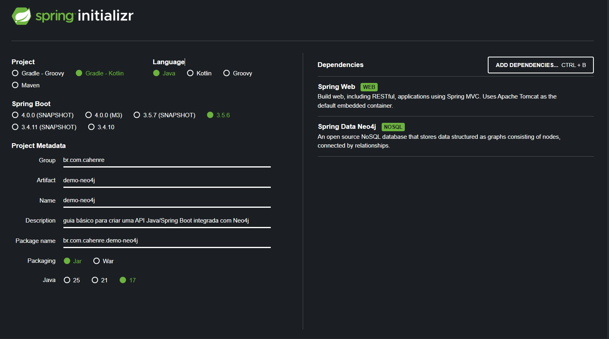
Configurar o projeto Spring Boot
graphql.org

Slide 31
Modelagem no Neo4j
Rede social
Comandos Cypher utilizados no nosso sistema
Visão detalhada da modelagem dos dados no Neo4j 1 Nodos (Nodes):
Usuário (User): Representa cada usuário da rede social.
Propriedades: nome.
Postagem (Post): Representa cada postagem no feed.
Propriedades: content (conteúdo da postagem), timestamp (data e hora da postagem), id (identificador único).
2 Relações (Relationships):
POSTADO: Conecta um usuário a uma postagem que ele criou. Indica que um determinado usuário fez uma determinada postagem.
CURTE (LIKES): Conecta um usuário a uma postagem que ele curtiu. Permite calcular o número de curtidas de cada postagem
Criação dos Usuários: 1 CREATE ( u : User { matricula : "2024100417" , nome : "Carlos Henrique Reis" } ) 2 Login(consulta usuário): 1 MATCH ( u : User { matricula : "2024100417" } ) RETURN u 3 Criar uma Postagem: 1 MATCH ( u : User { matricula : $userId } ) 2 CREATE ( u ) −[:POSTADO] − >(p : Post { i d : $postId , content : $content , timestamp : timestamp ( ) } ) RETURN p 4 Obter Todas as Postagens: 1 MATCH ( u : User ) −[:POSTADO] − >(p : Post ) 2 OPTIONAL MATCH ( p ) (p ) RETURN p
Notes:
what else is there? So I mentioned when answering the question, there are different connectors for Neo4j. There's BI connector, JDBC connector, the Kafka connector, the Spark connector for Neo4j. So you want to integrate Neo4j into other databases or data technologies, there are bunch of connectors. I showed you some of the drivers already. They are, these are the official drivers, but they are also drivers for other languages, like for instance, for Perl or Alexia, or Ruby, Rust and others that are contributed by the community. PHP as well. Graph Data Science is a really important topic. Where you take the graph, not just to build applications, but to get insights. And especially now with machine learning on graphs, there's a lot of really interesting stuff happening in this area. So if you're interested in that, check that out. We have visualization tool called Bloom, where we have separate trainings And then other integrations like really cool GraphQL integration for Neo4j. We have Spring for people that come from a Java ecosystem. Spring Data Neo4j has been one of my babies. GraphQL as well. Neosemantics integration with RDF data and pulling data back to Neo4j. Alex on Tuesday. And the update with, I mean help with utilities for Neo4j as well. So there's lots other cool stuff you can use to kind of build out Neo4j integration. So how can you continue from there? One is of course the Java session. So next the Bloom one, which is super powerful node visualization tool for Neo4j. GraphQL session, March 16th, and our data science team will talk about knowledge graphs and ML approaches for doing that. And if you follow this link, it gets you to this page where you to the other one as well. So please check them out and I'd look to see you there and such. Otherwise, I already mentioned GraphAcademy and we have a ton of videos on YouTube as well, both live streams, as well as webinars, graph connect talks, conference talks, and so on. And actually I have also conference coming up, just need to put in a teaser for that on graphconnect.com. Which is in person, I hope you'll make it there. And so it's on in June in Austin, Texas, and we can't wait to see perhaps some you have some of you there, if you can make it. If not, we'll stream, a number of those will be recorded as well, of course, right, so please join us there and we love to see if you can make it in Austin in June. And we are good.

Slide 32

Bora testar?
No grafo já foi cadastrado os nodes users:
É só usar o seu nome
https://neo4j.com/docs/cypher-cheat-sheet/4/neo4j-community/#_read_query
Notes:
Okay, and with that, I actually want to leave the slides and go into our database. So as you're the remember, we have our Movies database running. I hope for all of you your Movie database also is now green and running. And what you can do is you can click on this "Open with" button and pick Neo4j browser as our interaction tool because that's like an interactive query UI that allows us to query the data. And so we have our database connection URL already filled in, username is Neo4j and the password is what I just pasted here into my browser tab. And you hopefully stored it safely somewhere, right? So now I have my connection to my database. And because we started with the Movies dataset, this database is already filled with some example data, not a lot, but it's a small, cute, light, little tiny dataset, so we have Movies, People, and a bunch of relationships here. And it's 171 nodes and 253 relationships. So it's really just an example dataset. You can start by clicking on one of these. So for instance, you can click on People and say, okay, what do we have here? We have 25 people. It's says LIMIT 25, so we have 25 people. Here on the right side we have the legend for our nodes as such. So if you hover over a node or click on a node and you see the attributes of a node here. You can also fold this in and fold this out or make it bigger or smaller depending on what you want to do. And then if I have these people here, I can, on one side, I can just play chasing nodes all the two hours today. That's kind of one thing that I can do. But I can also click on this and say, "Expand relationships", which is this little icon down Or I can double click also on it. And if I do this, then I see Keanu Reeves acted in all these movies, right? And then I can pick one of those movies, like "The Matrix", for instance, click on that and expand it from here. And then I see suddenly other actors, right? You will be viewing Carrie-Anne Moss and Emil, which is actually a fake. So it's kind of for us to get rid of Emil later on. And then we have directors. So people that have a director relationship to "The Matrix". Lilly and Lana Wachowski, and producers as well. All right, so this is kind of our basic dataset that we can either explore interactively like I did here. So I can for instance, say, okay, what else did, for instance, Lana Wachowski in our dataset at least, write or direct or produce, right? So I can just expand the relationships here and then continue from there. So you can also see that or interactively, I can follow my things like I would draw them on a whiteboard for these kind of small example datasets. Okay. But let's go back to our query language because that's what we wanted to talk about. And as I mentioned in the beginning, Cypher is a pattern-based query language. So if you, by the way, if you want to go to multi-line mode, you can just press shift and enter or shift and return, and it goes into multi-line mode. So it starts out in single-line mode, which is this one, but if I press shift and enter, then this gives me here the multi-line mode. By the way, just quickly, there's more stuff here on the sidebar, so we saw already here the overview of the database on the property keys. I can see more information here. I can store favorites here. So for instance, if I have a query that I really liked, then I just click on this favorite button here. Save as Favorite and then it adds it here. And then I can pick it up from here again and run it and then so on. There are guides. So we can also look at this interactively. So if you get lost or if you don't want to type stuff, then you can also go to the guides and click on any of these queries and it puts them into the input field over here. And then you can use them from here. There are also more guides available and then there's help links to important commands like help keys, quite important. And then other commands as well which are quite useful. Like history is an important command because if you want to look at what you've typed so far and want to save this, for instance, then you can do this. Or what you can also do is show the schema. So for instance, if I click here Run, then I see I have my schema between Person and Movie. And a Person can follow a Person, and Person can acted in, review a movie, produce a movie, write a movie, or direct a movie as well. So I can see actually visualization of my graph schema, of the data and my graph, and a bunch of other things. And then links to docs and to developer guides and GraphAcademy and many other things as well. Settings, most of them, we don't need to touch today. And there's only one that I think it should be checked for you, it's called Connect result nodes which is useful for beginners. When we start our graph database later on, you might want to disable this because that fetches additional connections between nodes that you return. So if I return a bunch of nodes, the browser actually goes and fetches additionally what connections exist between these node. Do you to have a nice graph visualized? But if I already could know what I want return then this Connect result nodes is not so helpful. And then bunch of license links over here. Okay, but what I want to do is we want to interactively look at Cypher. And for that, I just picked my query that I took from click on Person here, and go with this as a starting point. And then we go from here. So I'll turn this into a full screen frame here. So the frame is full screen, and then I can zoom in and out. That's actually a new feature that's actually just made it. So zooming in and out with just my mouse wheel is something that I've been waiting for a long time. So that's really great. And the new features also fit to zoom, which kind of fits my whole graph into the visualization. That's also nice. Okay. But what we want to do is kind of look at some of the Cypher aspects that we can do here. So I just moved us into a multi-line thing so it's easier to edit and move stuff around. So fifth thing that I wanted to show you is kind of these patterns here, right? Here I return the people and then I expanded them. But what I can also do is I can say, okay, give me all nodes, right, give me just 25 random nodes. So I just move this colon person. And then if I do this, then it returns both People and Movies at the same time. And then you see the connect result node actually goes off and creates all these connections between my People. So even by just fetching a bunch of nodes, I get all the visualization of the graph as such. If I don't add a limit, the browser gets a bit too little slower. This needs to basically in JavaScript manage all this graph visualization. There was a recent update to the graph visualization library. So it's a little bit better today, even with a larger data event. So for instance, this is like almost a whole movie database on one screen. And we see kind of clustering around nodes. Like the actors and directors clustering and around nodes. There are some nodes that have joint repeated actors and directors like here is "The Matrix" trilogy. So we don't have like the current movie in here and so on, right? So there's this kind of stuff. So this LIMIT I just say how much data is returned for my query and I just put it back to 25. And this is basically showing me a number of nodes and relationships. This "n" here is a variable, right? So I can call this whatever. I can call it foo or bar or m for movie or n for node. Whatever I want to call it, I'll spell it out. For instance, if I say, I want to just see movies, then I say Movie and then colon Movie is the label. And I just want to return movies. And so it returns 25 movies for me, right? And so whatever I call, this is not important. It's just for me. And I use this to later reference this element I found in my pattern as well. Right. So one thing that we can do with our elements is we can, I already mentioned that we can look at attributes here on in the side bar. But we can also look at the table view of our result, which then shows us the properties. So each movie has a tagline, a title, and a release here, and we can also have a nice ASCII table of this. So if you want to copy the results somewhere, then you can copy this ASCII table quickly as well. Okay. The other thing, if we return like nodes and relationships from our graph, then we see the graph visualization here immediately. But of course you can also return individual properties only. So for instance, we know that movies have titles and a year. And so I just say RETURN movie.title and movie dot, oh it's released, right? Oh, that's actually, of course, how could I forget? There's actually full Visual Studio Monaco code editing support. So you'll get also like highlighting and other things and code completion as well. If you press F1, you get even like typical VS Code commands as well, which is quite nice. So if you want to capitalize something or someone, right? So for instance, if this return was lowercase and I wanted to make it uppercase and I press F1 and then uppercase, Transform to Uppercase, and then my return is beautifully like this. Okay., and if I return this actually movie.title and movie.released, then I get the table back with just these attributes, right? So I can do this both for nodes and relationships. If I just want to return attributes then I can do this. And please come along with me and type these things and do it yourself so you get the feelings for the language. Don't just watch me doing stuff. I actually urge you to do it yourself. Okay, so we had our movies here that we had returned in our graph visualization and what I did before about like this manual expanding from movies to actors, you can actually also do in our query language as well. So for instance, if I want to say I have a person which has some kind of relationship to our movie, so I pass just basically the movie and the person. And if I had Connect result nodes, actually let me disable Connect result nodes. So it's a little bit more obvious. So I just go to settings here, I disable this. So if I return find a movie and a person as such and return them, let me call this person. Then I basically just get independent pairs of nodes, right? So I get a bunch of, let me make this full screen again. I get a bunch of people and a bunch of movies, and then it limits them to 25 as such. So we have only one person actually here. But what we actually want to do is we don't want to just see the movies and the people, but we want to have the people that had some role in the movie, right? So and what we do is basically we just add an arrow here. So if you squint a little bit, you can see that these round parentheses around nodes are actually like the circles on the whiteboard, right? So we can just complete circles. And then we have our little circles and the whiteboard, or here in our graph visualization. And you could imagine that these are like the round parentheses here. And similar for relationships, we just add two dashes and then greater than sign and then we have an arrow. So this even has fun ligatures that you can also enable and disable, I think. And so we can say people and their relationships to a movie, but right now, if I just run this, then the relationship should not be returned. I still will get the people on the movies because I here a variable.

Slide 33
Então, como continuo minha jornada com grafos?
Notes:
How do I get started with Graph Apps?

Slide 34

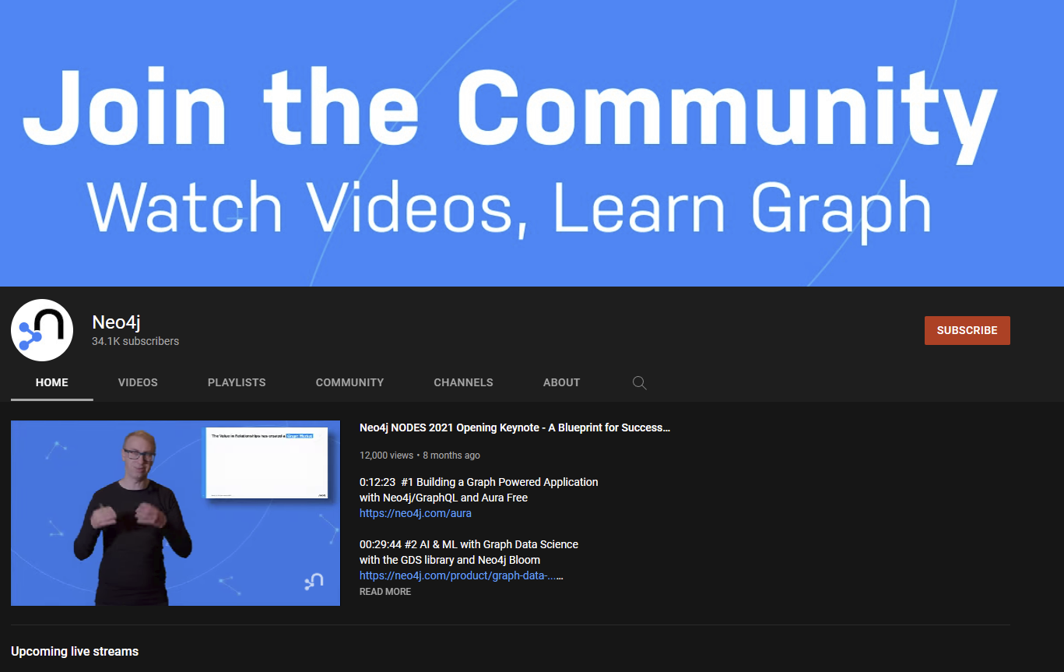
Continue a sua jornada
Treinamento e certificação gratuita:
dev.neo4j.com/learn
dev.neo4j.com/datasets
neo4j.com/developer
Melhores práticas e experiências práticas:
dev.neo4j.com/videos

